Slide 1



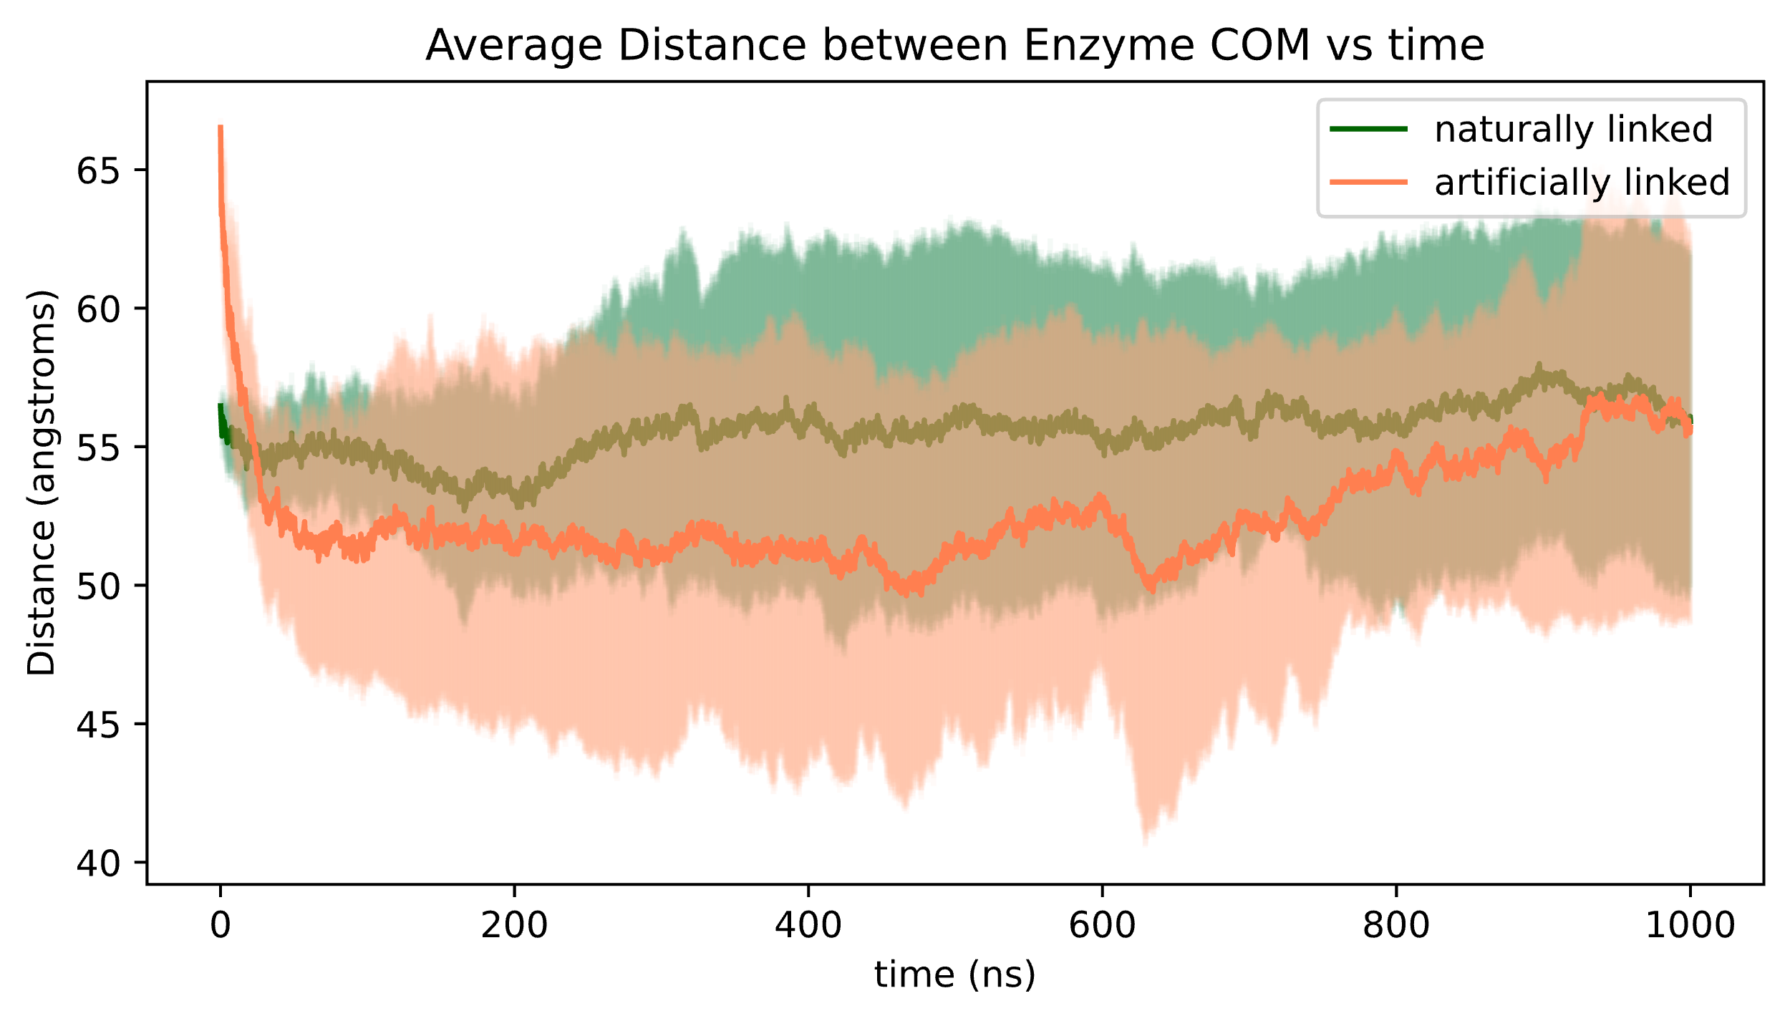
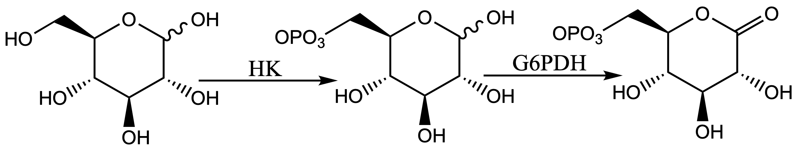
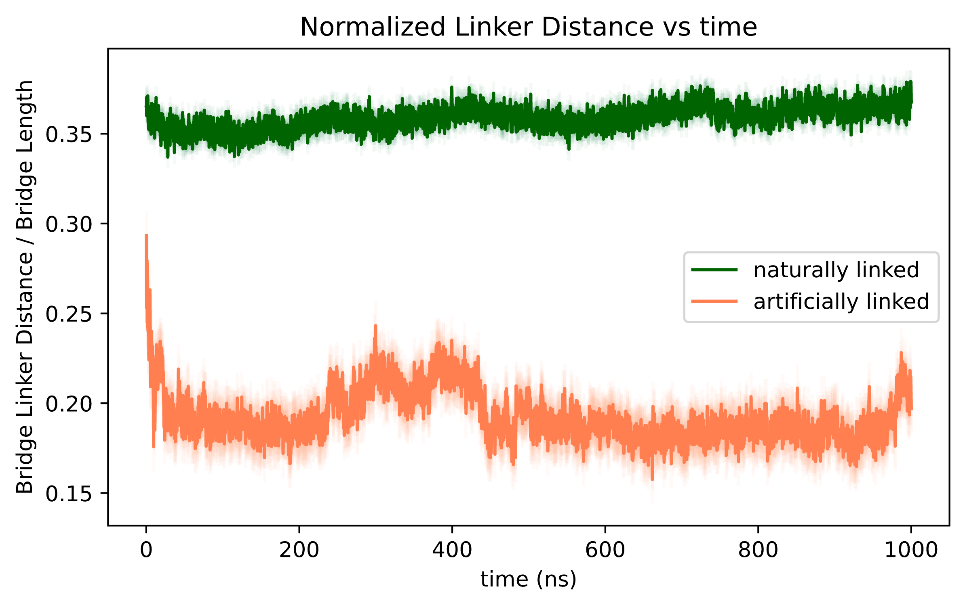
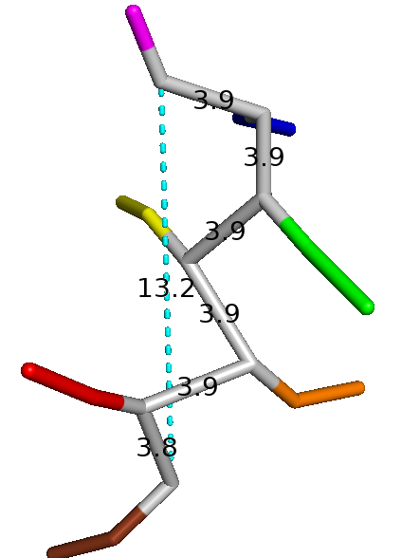
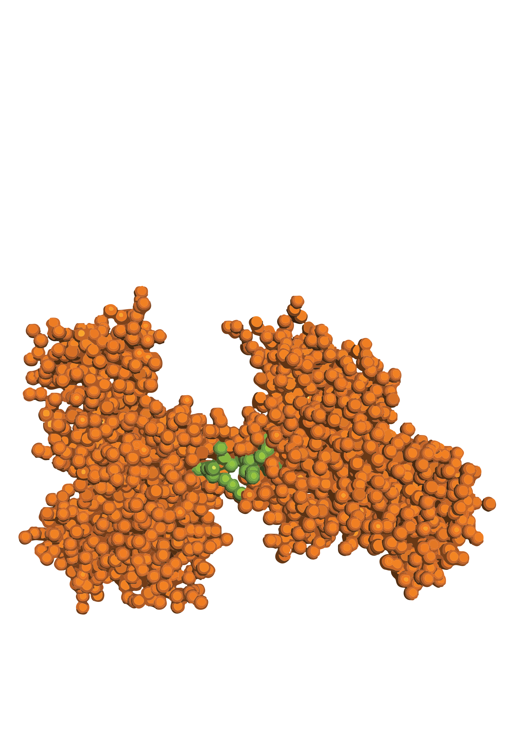
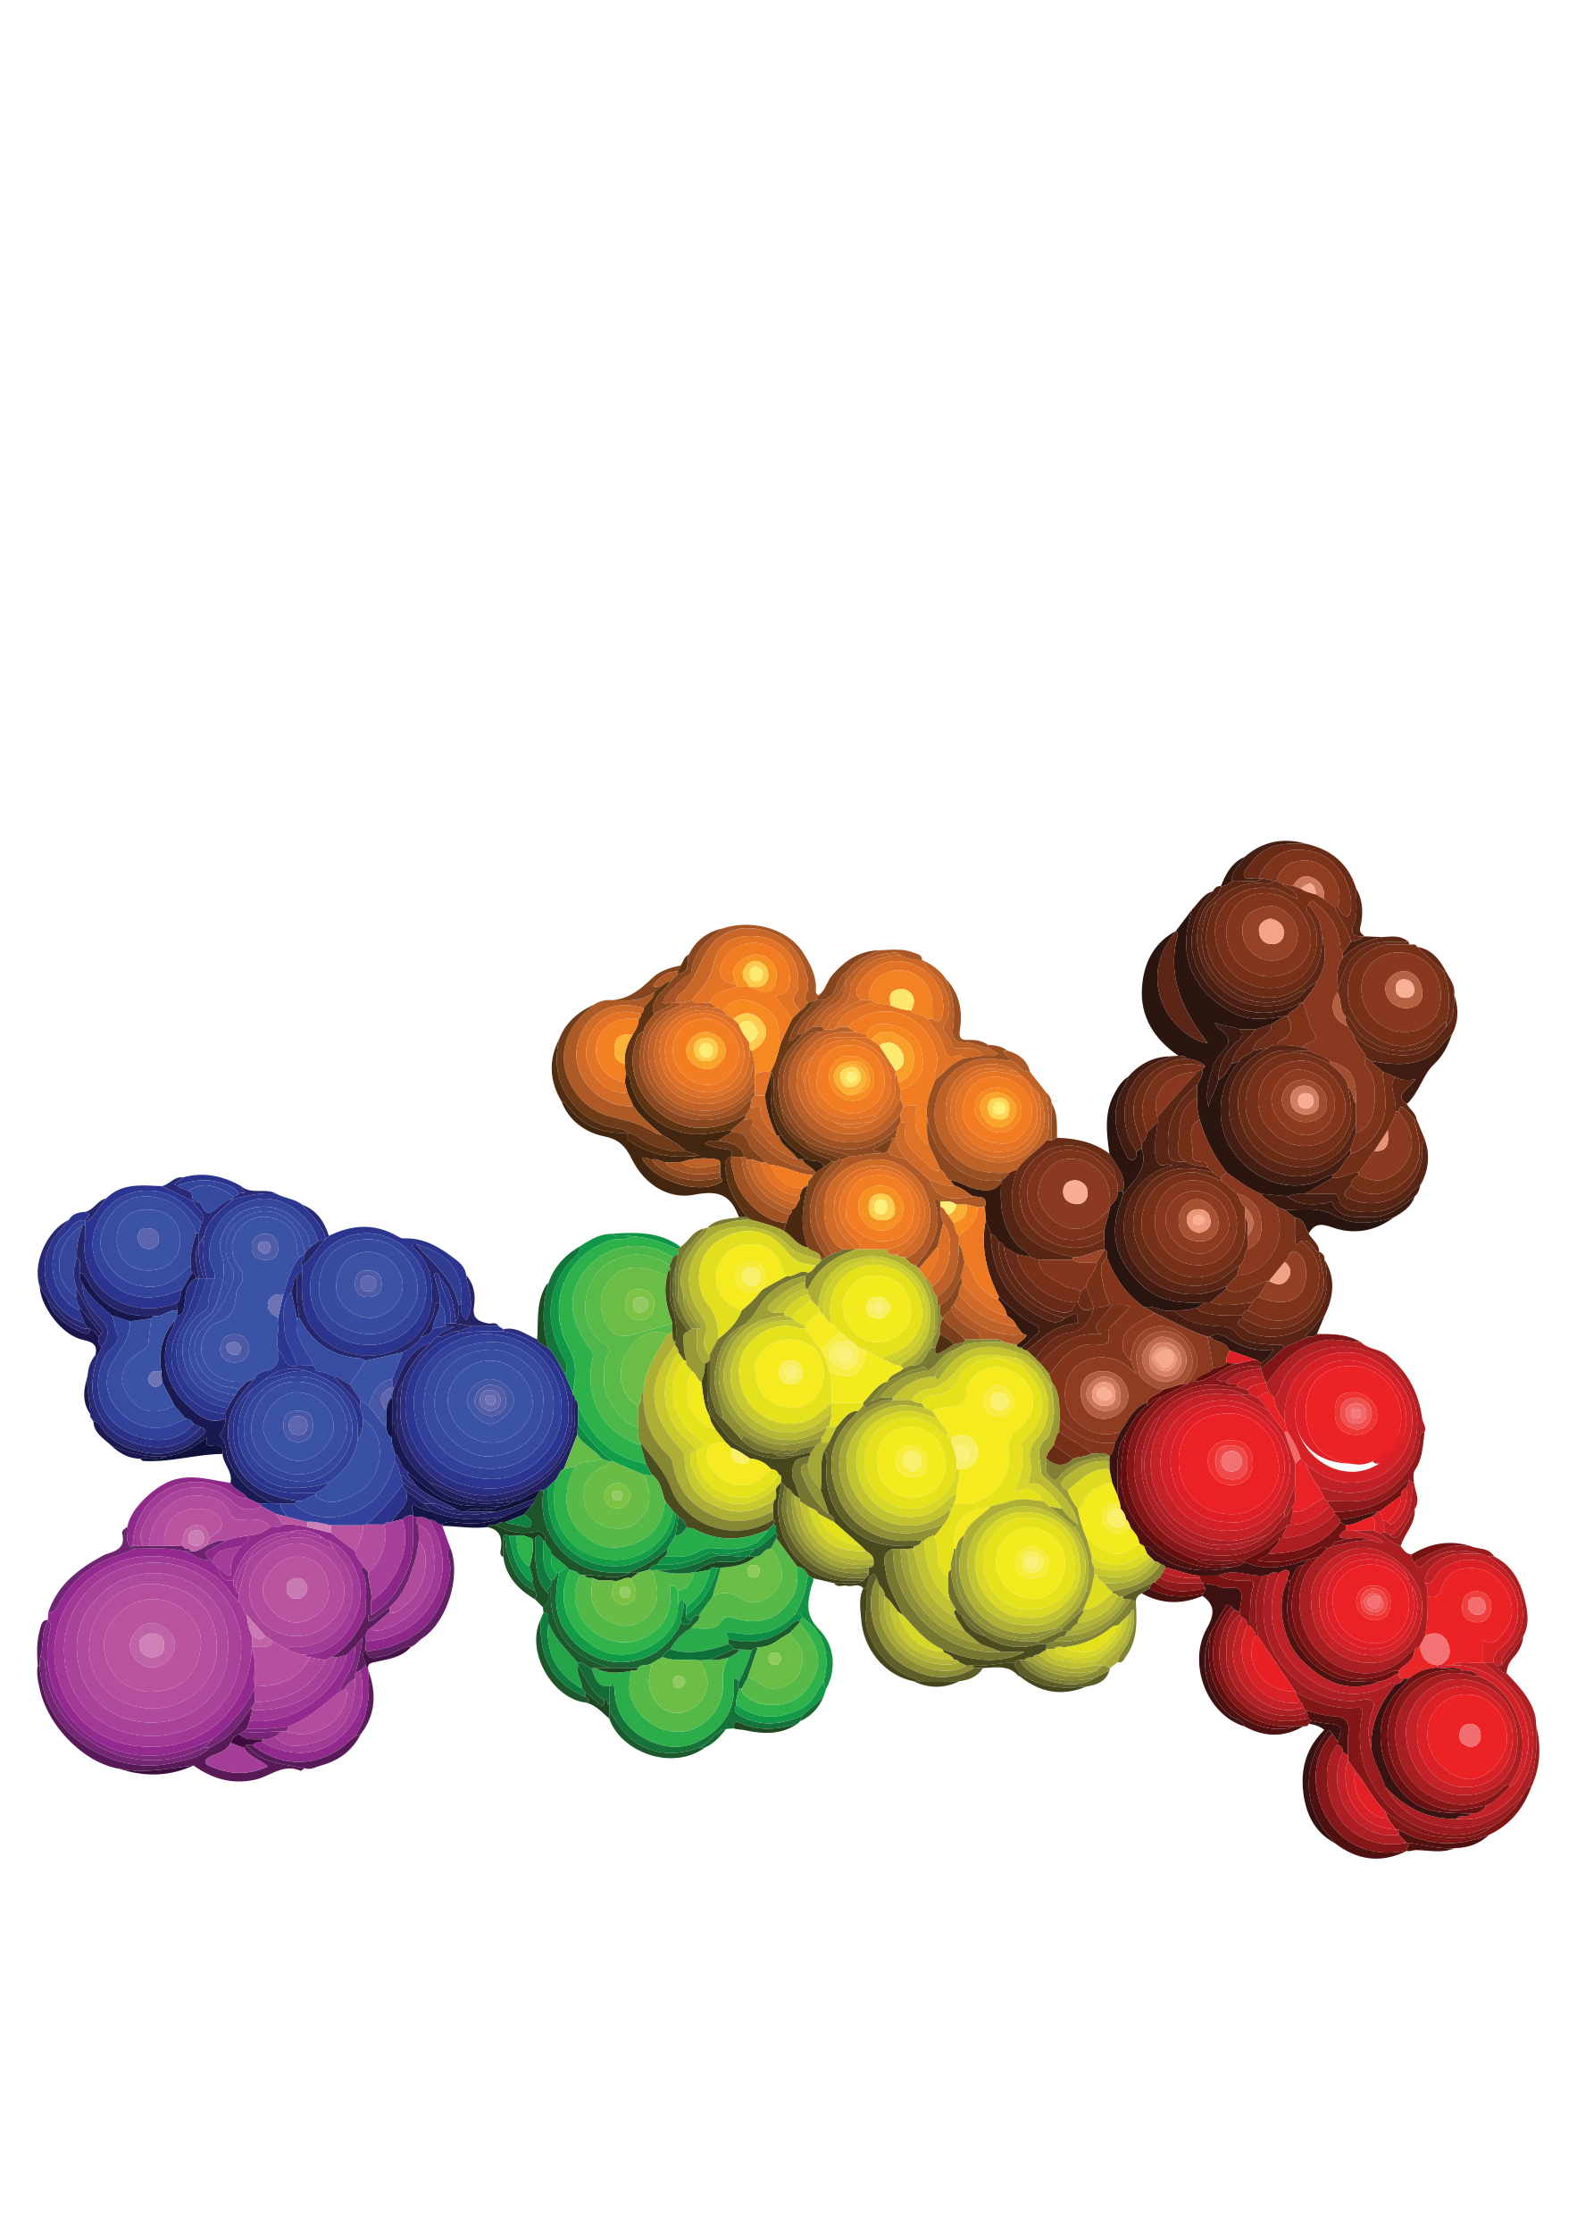
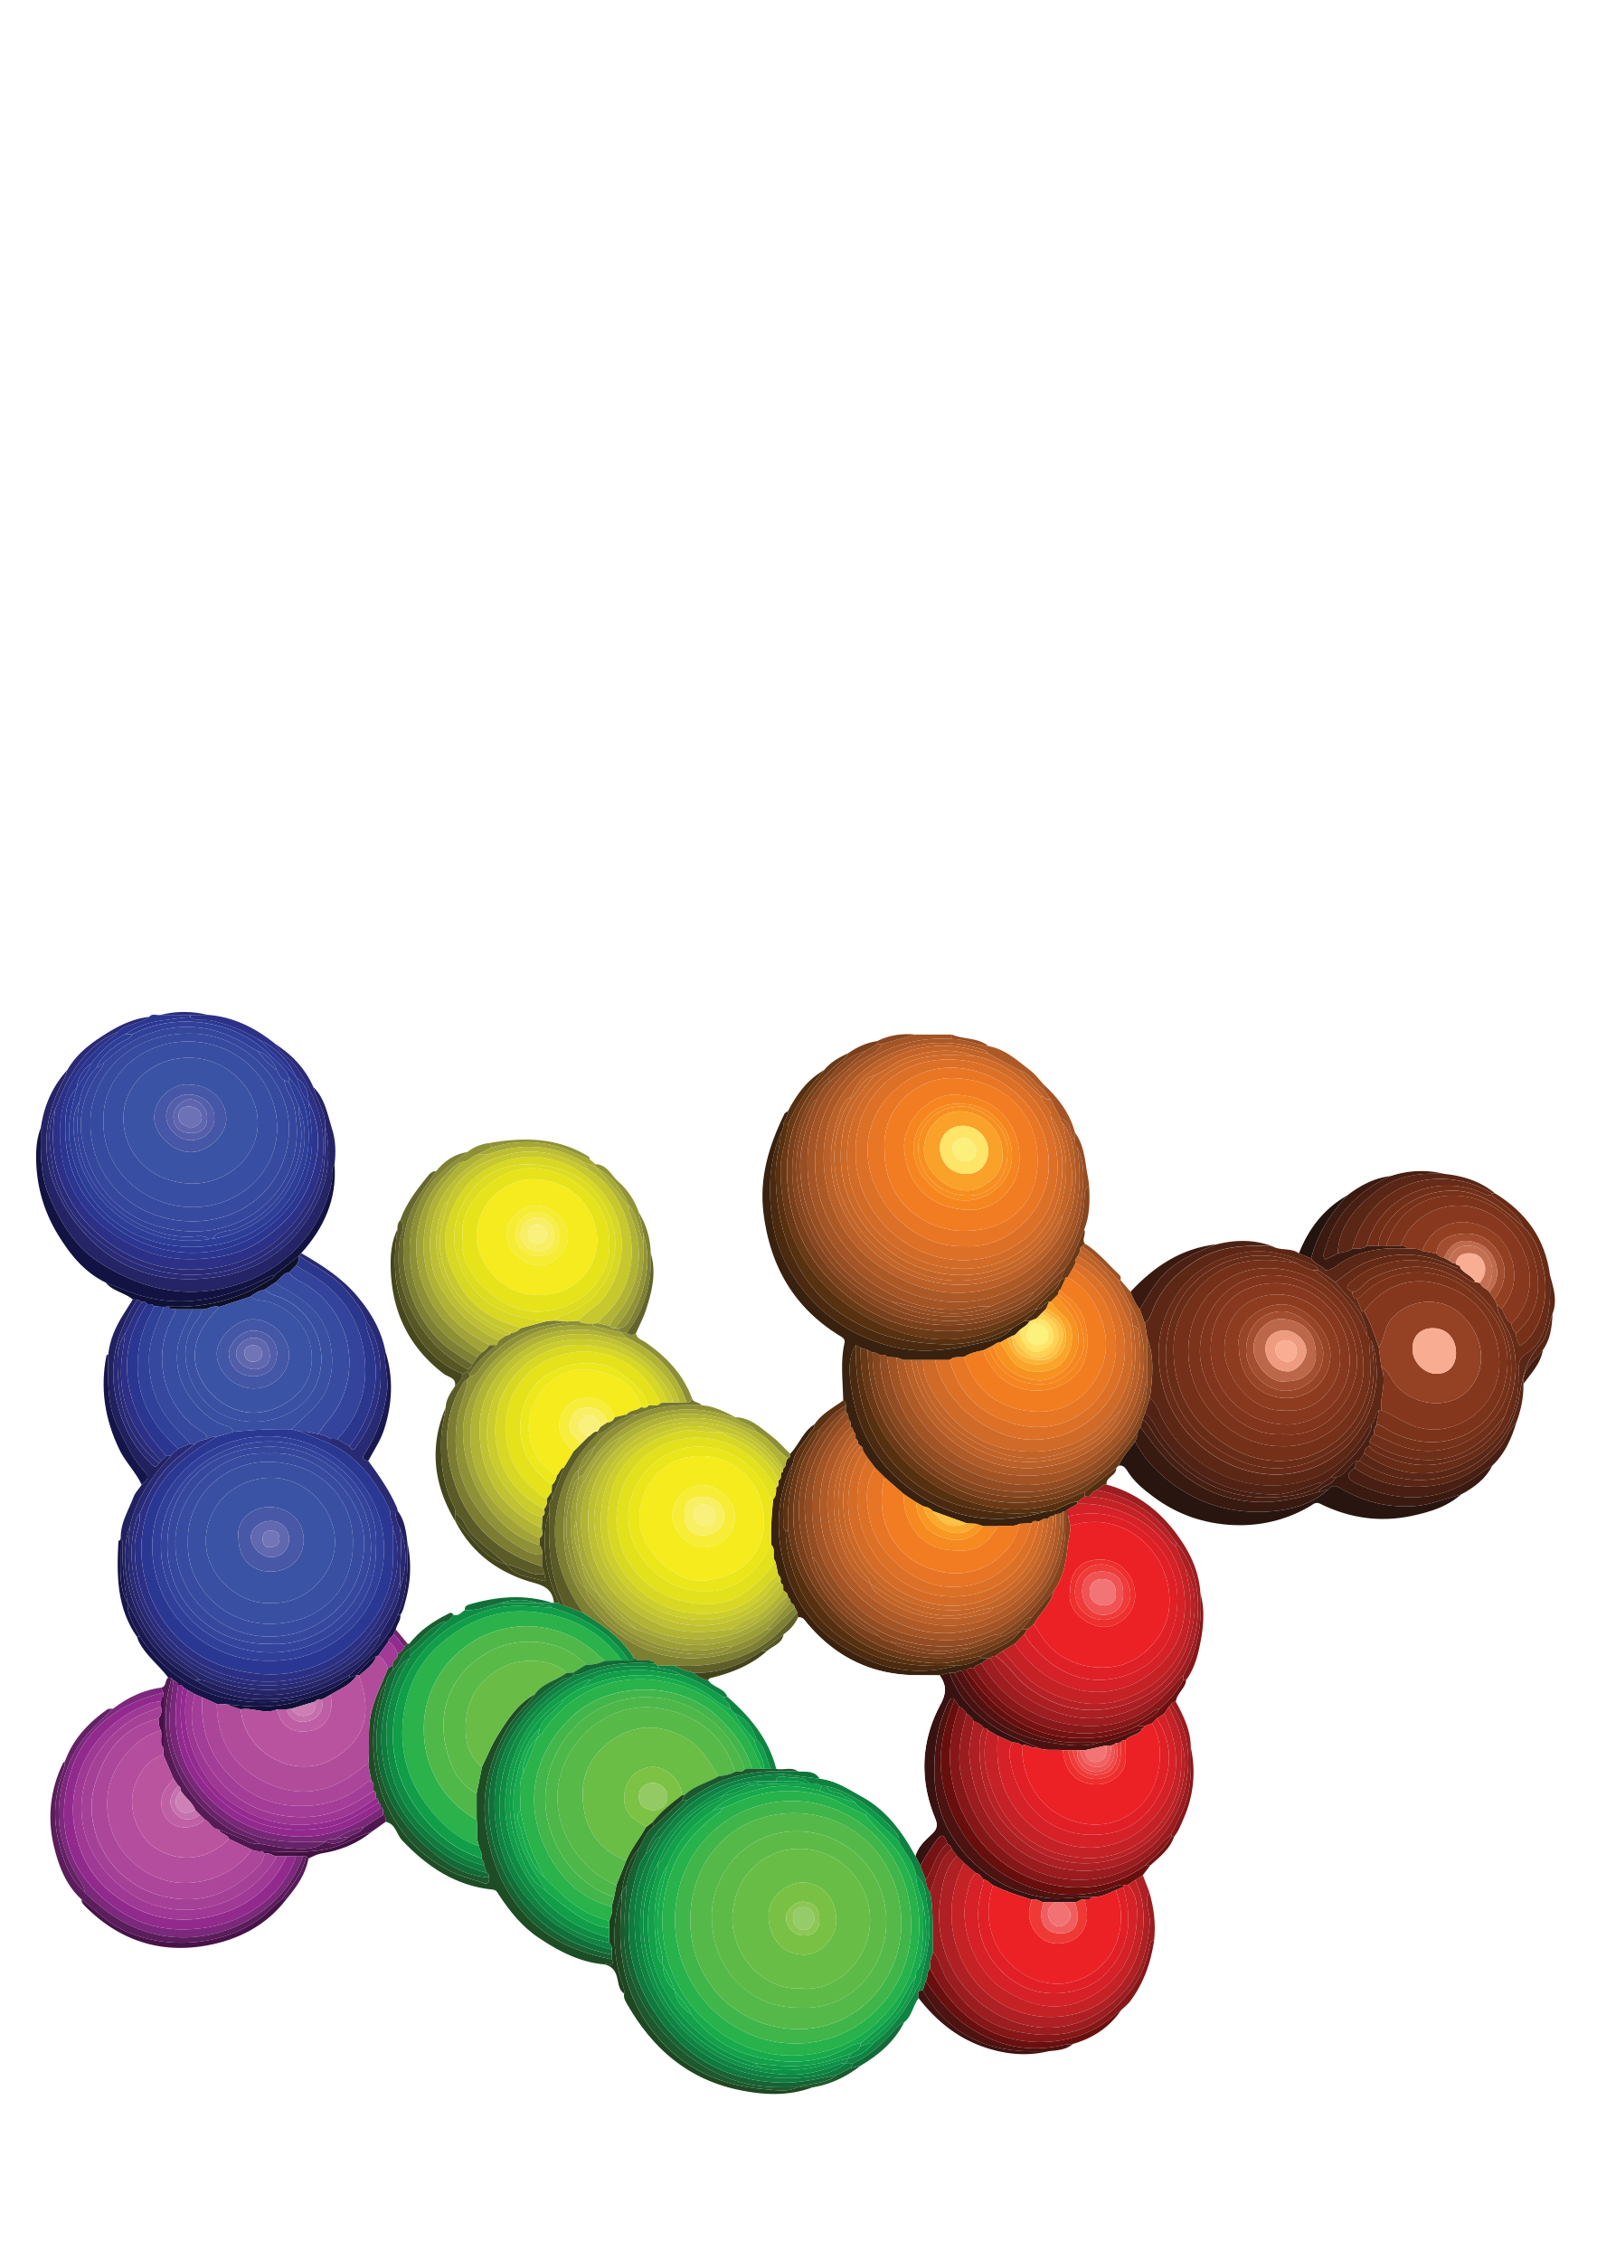
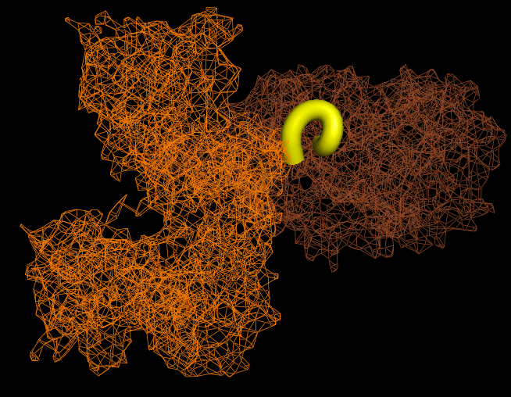
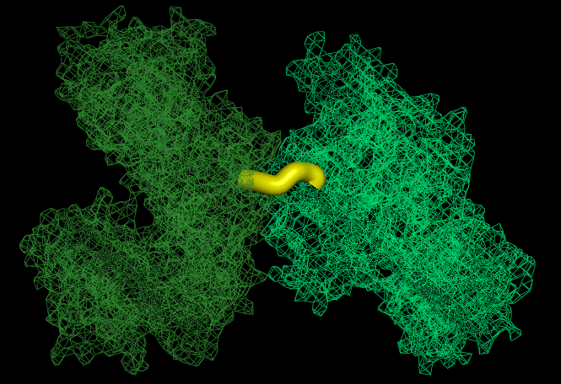
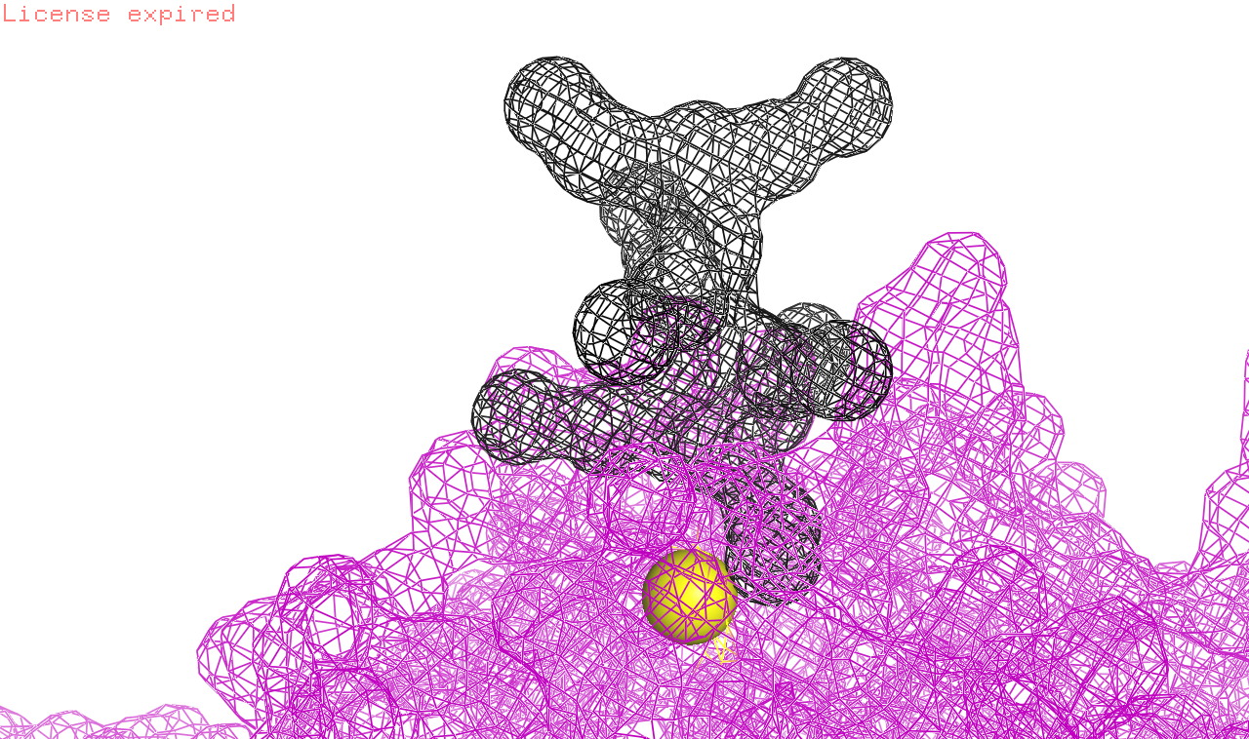
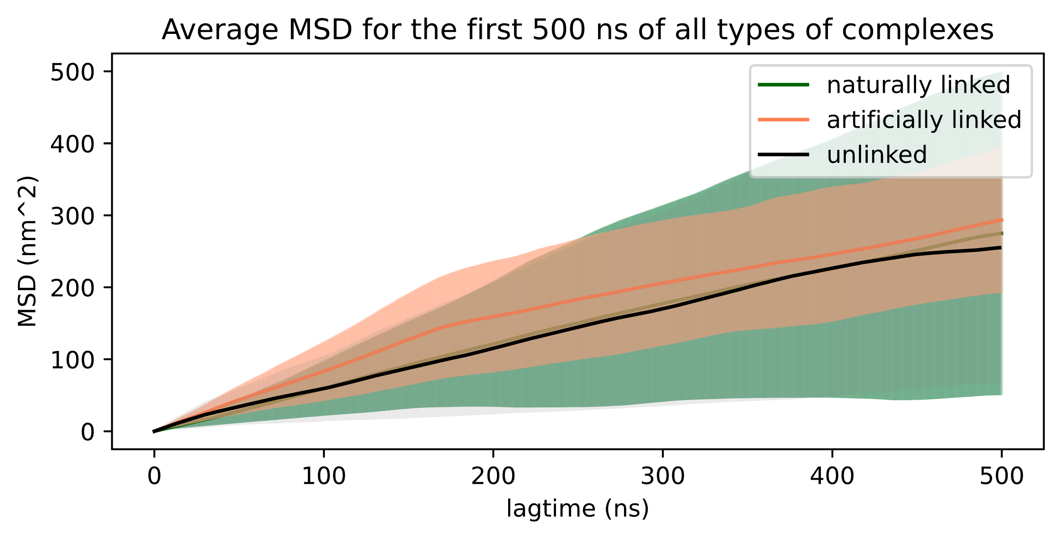
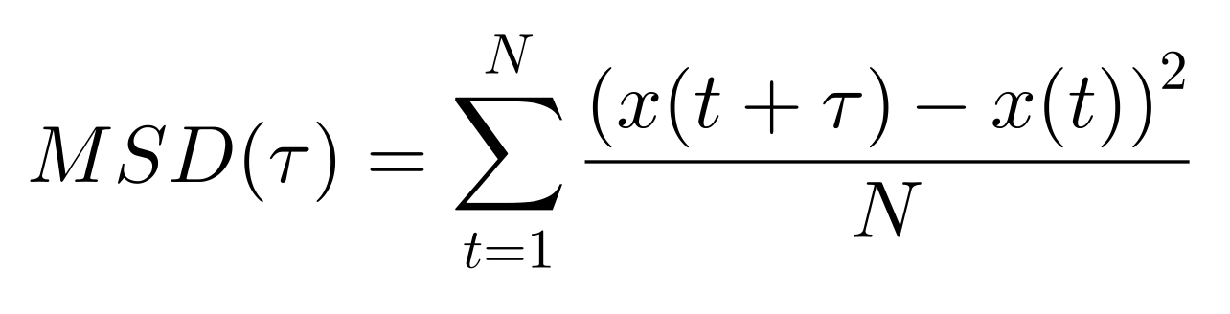
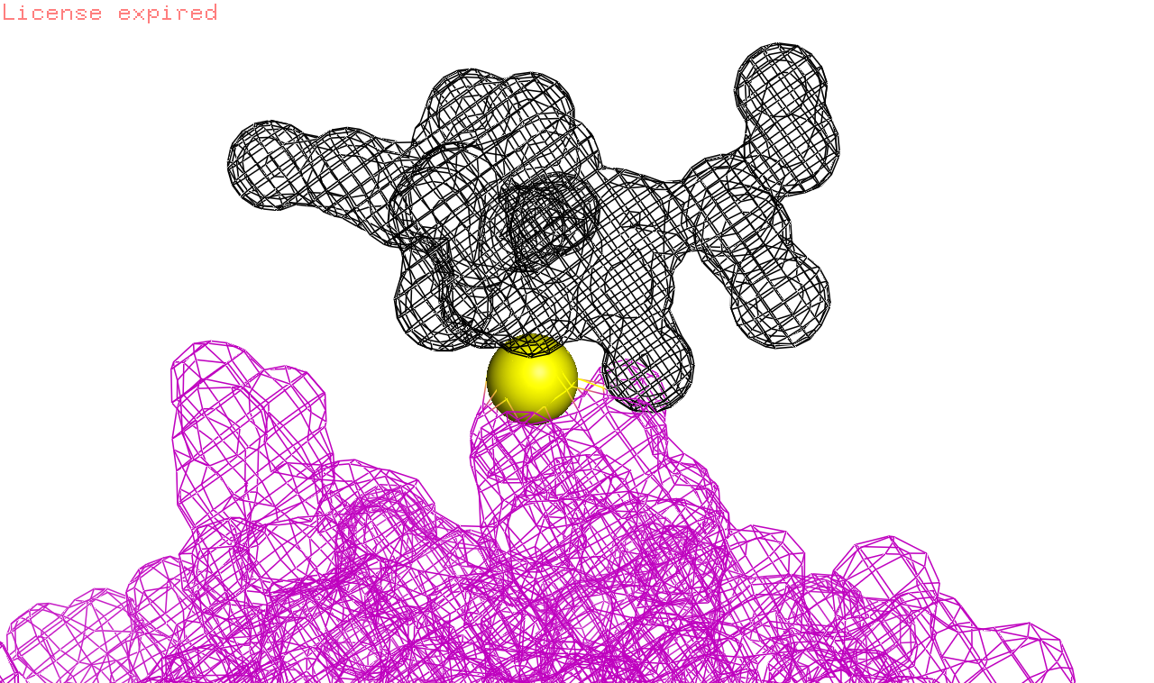

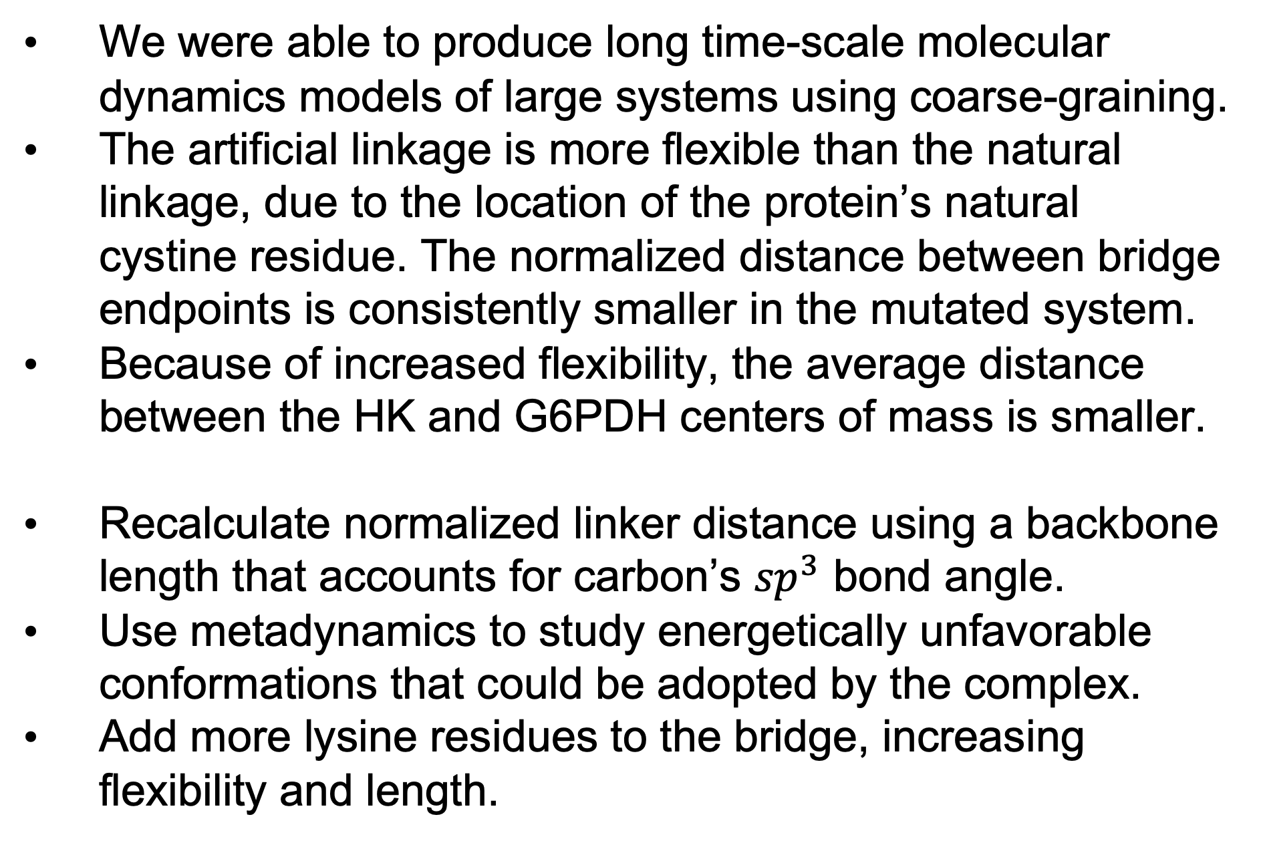
Linking Enzymes and Limiting Dynamics
Meiers Dixon , Christina Wark , Scott Calabrese Barton
Bucknell University, Michigan State University
1
2
2
1
2
Background
Results
Coarse-grain (CG) modeling allows for increased computational speed due to the simplification of the atoms in the system [1]. In this project, we analyzed the interaction of Hexokinase (HK) and Glucose-6-phosphate dehydrogenase (G6PDH) from the pentose-5 phosphate pathway. These enzymes were covalently joined by a positively charged poly-lysine bridge designed to efficiently transport the negatively charged intermediate [2].
Model​ | Performance​ | Number of Protein Atoms​ | Number of Solvent Atoms​
Atomistic HK​ | 10 ns/day​ | 14791​ | 115347​
Coarse Grain HK​ | 244 ns/day​ | 2038​ ​ | 20052​
Table 1. Using CG can increase the computational speed of a simulation by 25 times, while reducing the number of atoms in the system. CG allows for longer timescales than atomistic simulations but are less accurate models.
A
B
Fig. 6. Distances between HK and G6PDH centers of mass (COM) over time. The distance between enzymes in the artificially linked system is slightly less than that of the naturally linked system. Because the bridge is kept straighter in the natural linkage, there is less flexibility compared to the mutated system. The artificial linkage allows access to more conformations.
Fig. 1. Reaction scheme of HK and G6PDH. The product of HK is the substrate of G6PDH.
Objectives
Conclusions and Future work
Generate disulfide bonds to connect bridge and enzymes
Coarse grain the entire complex while preserving the bridge-protein linkages
Select an effective method of attaching HK and G6PDH
Determine effect of bridge-protein linkage type on the stability of the bridge
We were able to produce long time-scale molecular dynamics models of large systems using coarse-graining.
The artificial linkage is more flexible than the natural linkage, due to the location of the protein’s natural cystine residue. The normalized distance between bridge endpoints is consistently smaller in the mutated system.
Because of increased flexibility, the average distance between the HK and G6PDH centers of mass is smaller.
Recalculate normalized linker distance using a backbone length that accounts for carbon’s ${sp}^{3}$ bond angle.
Use metadynamics to study energetically unfavorable conformations that could be adopted by the complex.
Add more lysine residues to the bridge, increasing flexibility and length.
C
D
A
Coarse Graining
B
G6PDH
HK
Bridge
Fig. 2. CG and Complex Structure. (A) After CG, the number of atoms in the bridge reduces greatly. (B) HK and G6PDH shown in orange are linked by the bridge shown in green. Image taken after CG.
Method
Fig. 4. Normalized distance between ends of the bridge. (A) Distance between beads at bridge ends divided by the sum of length of the bridge backbone. When the ratio approaches 1, the bridge straightens out. The naturally linked enzyme is much straighter than the artificially linked enzyme, likely because the artificial cystine is on the enzyme surface. (B) Diagram showing backbone length versus distance (angstroms) between end beads. (C, D) Diagrams showing artificial linkage in orange and natural linkage in green. The left enzyme is HK in both pictures.
Coarse graining was done via CGMartini [3]
Linker chemistry and disulfide bonds
Natural cystine linkages vs artificial cystine linkages vs no linkages
For every system included here we did at least 6 trials, and assumed a neutral solution with temperature of 320 K
A
Naturally Linked
References
[1] Saunders, M. G.; Voth, G. A. Annual Review of Biophysics 2013, 42, 73–93. https://doi.org/10.1146/annurev-biophys-083012-130348.
[2] Xie, Y.; Calabrese Barton, S. Physical Chemistry Chemical Physics 2021, 23 (23), 13381–13388. https://doi.org/10.1039/d1cp01304a.
[3] Souza, P.C.T., Alessandri, R., Barnoud, J. et al. Nat Methods 18, 382–388 (2021). https://doi.org/10.1038/s41592-021-01098-3
B
Artificially
Linked
Acknowledgements
Fig. 3. Two methods of bridge-enzyme. The purple surface shown is G6PDH. (A) Bridge linked to C268 and (B) P265C marked in yellow. The artificial cystine was created via a mutation in PyMol.
Fig. 5. Mean Squares Displacement of all three experiments. Lag times were graphed for the first 500 ns of the 1 microsecond simulations. MSD was calculated with MDAnalysis according to the equation shown above, where 𝜏 = lag time.
NSF ACRES REU – 2349002

